Slide 1

ENGR7761 – Image Processing Labe 1: Introduction to Python
Lecturer: Paulo Santos
paulo.santos@flinders.edu.au
Office: 4.24

Slide 2
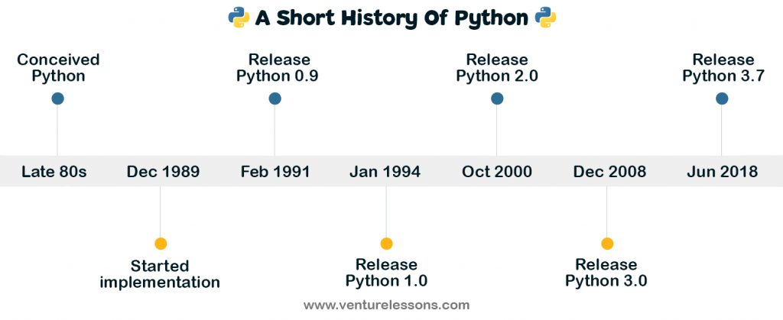
Python
Guido van Rossum @ UvA
Open source
Very high-level language (VHLL)

Slide 3
Monty Python's Flying Circus
http://ecx.images-amazon.com/images/I/51HrlSsUrwL.jpg

Slide 4
Why Python?
Increases developer productivity wrt C, C++, Java
20 or 30% fewer lines of code
Faster code checking → better maintenance
Clear syntax:
name = input(‘Type your name:’)
print(“Hi { } :”.format(name))

Slide 5
Why Python?
C
Java
#include <stdio.h>
int main(){
char name[200];
printf(“Type your name: ");
scanf("%s", name);
printf(“Hi %s :)\n", name);
return 0
}
public class Hello {
public static void main(String args[]) {
java.util.Scanner s = new java.util.Scanner(System.in);
System.out.print("Digite seu nome: ");
String nome = s.nextLine();
System.out.println("Olá " + nome + " :)");
}
}

Slide 6
Why Python?
Large number of standard libraries:
https://docs.python.org/3/library/
Can be extended with third part libraries:
There are over 60,000 on Python Package Index:
https://pypi.python.org/pypi?%3Aaction=index

Slide 7
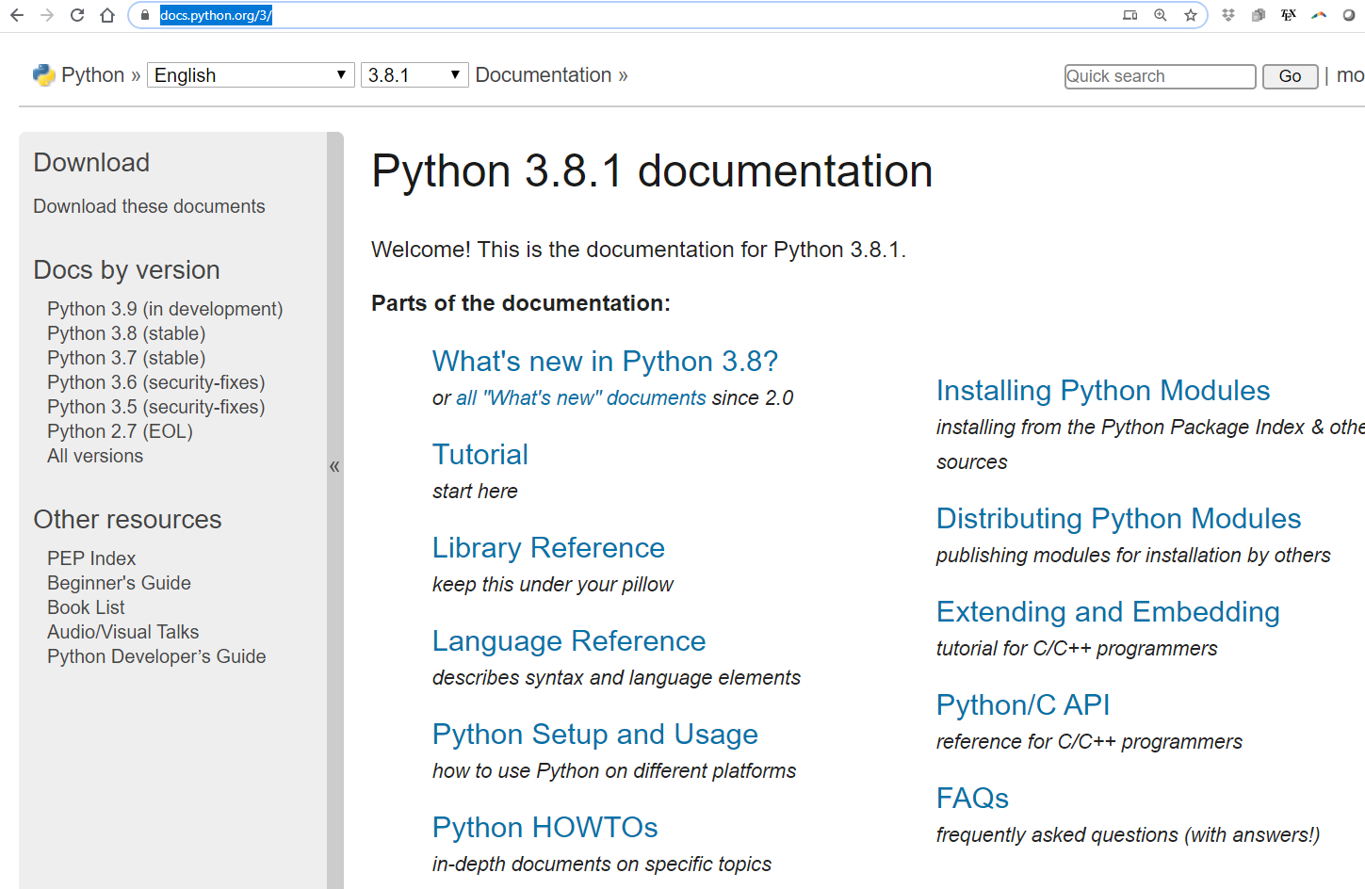
Where to learn?
https://docs.python.org/3/

Slide 8
Crash course on syntax
No need for ‘;’ at the end of commands
No need code delimiters (e.g. { })
But indentation is mandatory…

Slide 9
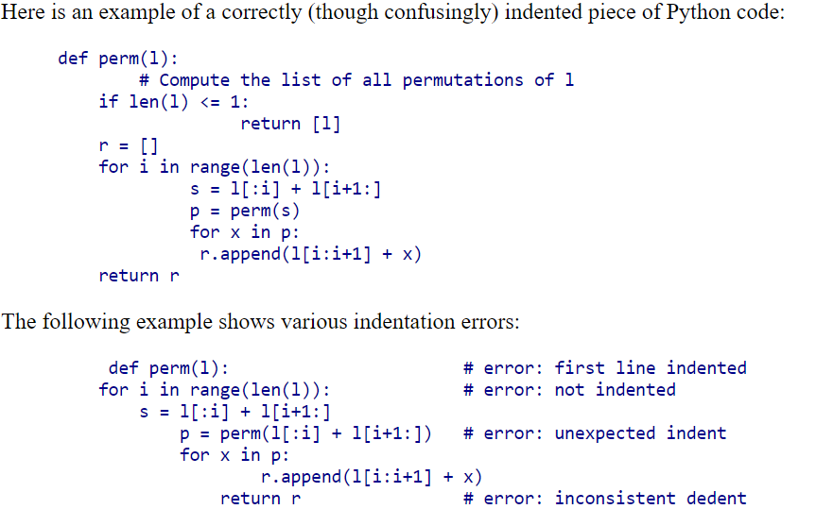
Indentation is mandatory
https://docs.python.org/2.0/ref/indentation.html

Slide 10
Installation (that we’re going to use)
Install anaconda
https://www.anaconda.com/download/
Python 3.7
Download the libraries
Open an anaconda prompt
Go to the directory with the .yml file
Type:
conda env create –f cvcourse_windows.yml
Then, if installation was successful:
conda activate python-cvcourse

Slide 11
https://xkcd.com/353/

Slide 12
Strings
Usually a sequence of characters
Need delimiters:
“Flinders” or ‘Flinders’
‘123’ or “123”
etc

Slide 13
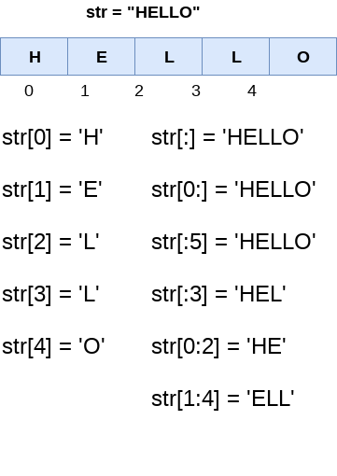
Strings: indexing and slicing

Slide 14
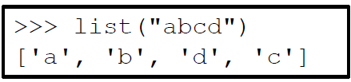
Strings
Start from the index ‘0’
Any types of elements

Slide 15
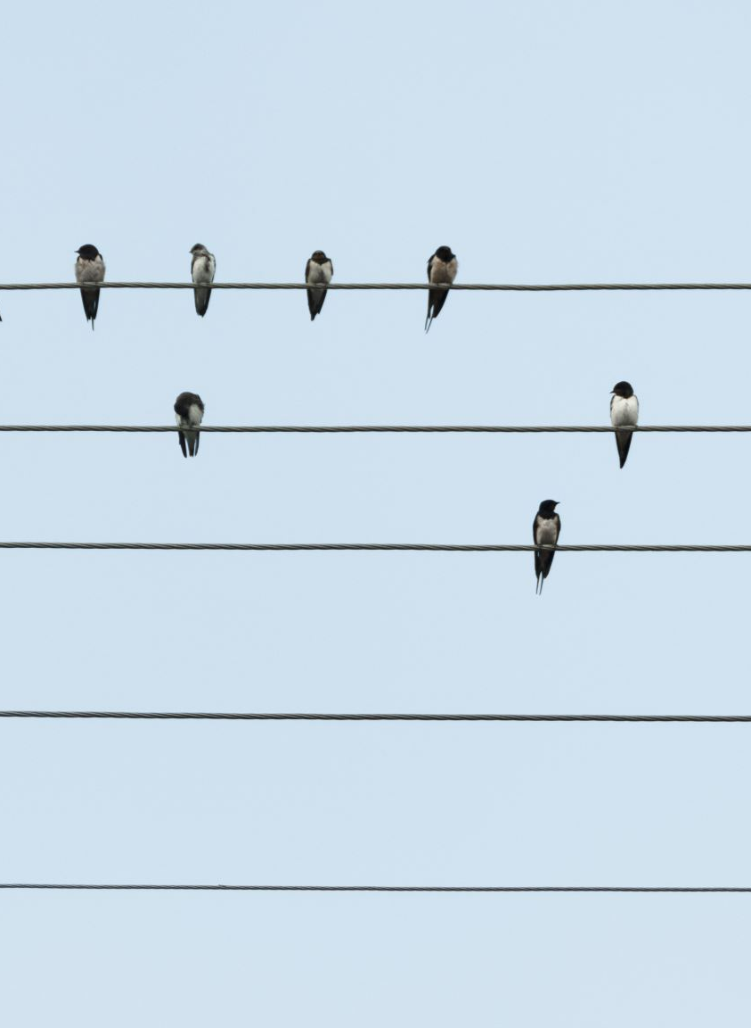
Strings
Open the file: lab1-strings.ipynb on Jupyter

Slide 16
There are other basic types…
Tuples:
Dictionaries: {key:value}

Slide 17
Control Structures
Repetition
Decision
If/else
conditional
iteration
for
while

Slide 18
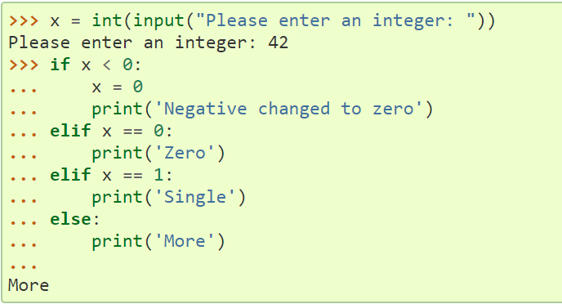
If/else
https://docs.python.org/3/tutorial/controlflow.html

Slide 19
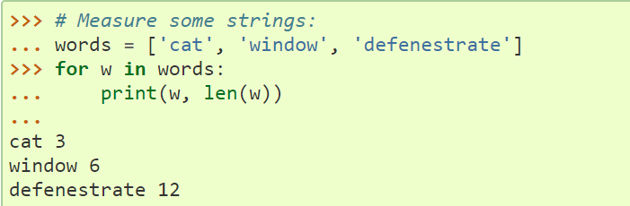
for

Slide 20
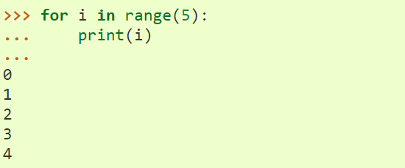
For (the range() Function)

Slide 21
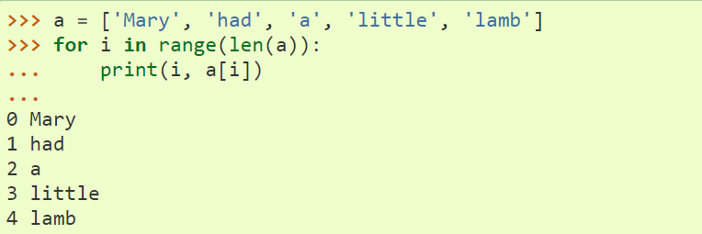
Iterate over a list

Slide 22
Control structures
Open the file: lab1_control_structures.ipynb

Slide 23
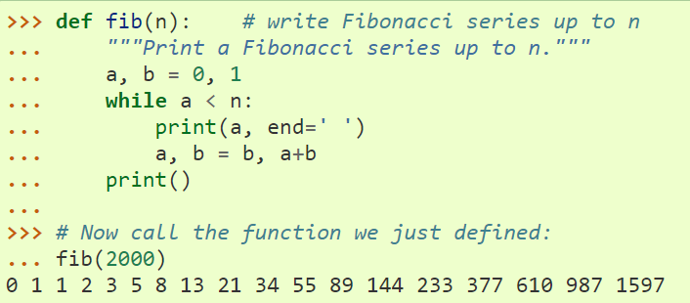
Functions

Slide 24
Functions
Open the file: lab1_functions.ipynb

Slide 25

Crash course on NUMPY
Python library for large, multi-dimensional arrays and matrices
Large collection of high-level mathematical tools
https://docs.scipy.org/doc/numpy/user/quickstart.html

Slide 26
Numpy
Open the file: lab1_numpy.ipynb

